Slide 1

Advanced Database Systems
Professor Joann J Ordille
jo531@scarletmail.rutgers.edu
Fall 2022
Photo by Jack Moreh from Freerange Stock

Slide 2

Overview
Cloud Native Architectures
Enabling Technologies
DevOps Processes
AWS Academy Modules
Upcoming Assignments
Photo by Jack Moreh from Freerange Stock. Remaiinder © 2022 Joann J Ordille, joann.ordille@rutgers.edu

Slide 3

Enabling Technologies

Slide 4

What is virtualization?
Providing an abstraction of the computing hardware or operating system to facilitate:
Programming
Management
Portability
Scalability
Hardware Virtualization
May make the computer memory in a program look contiguous and larger than it is (typically) for ease of programming and better performance.
May make one machine look like many CPUs, so each programmer or user has the experience of having a dedicated machine.
May make one machine capable of running many operating systems, so each system or user has the experience of having a whole dedicated machine.

Slide 5
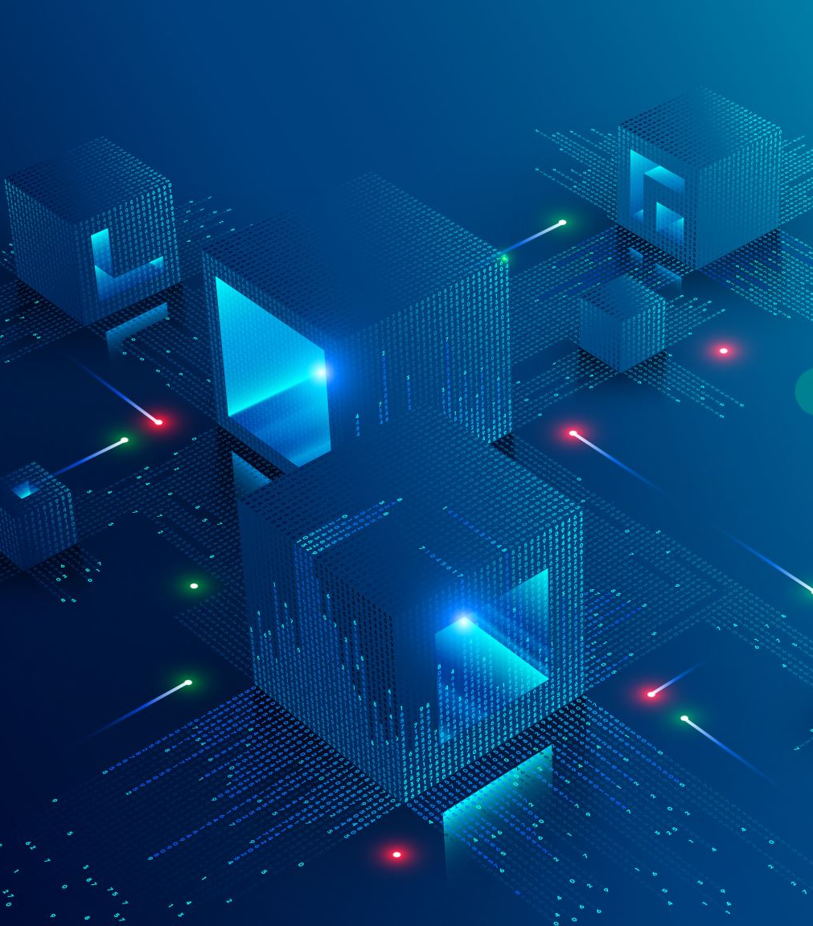
Virtual Machine
The illusion of having an entire dedicated machine while running with other virtual machines on the same physical hardware
A software abstraction layer called the hypervisor provides this illusion

Slide 6
Hypervisors
Type 1 hypervisors run directly on the hardware (on the bare metal)
Guest OSs run in VMs managed by the hypervisor. The Guest OSs can differ from each other.
Type 2 hypervisors run on the host OS which runs directly on the bare metal
Guest OSs run in VMS managed by the hypervisor. The Guest OSs can differ from each other and the Host OS.
Guest OS
Guest OS
Guest OS
Guest OS
Guest OS
Guest OS
Hypervisor
Hypervisor
Host OS
Hardware
Hardware

Slide 7
AWS Elastic Compute Cloude (EC2)
Provides a variety of virtual machines by size (CPU, Memory)
Check out the options in the management console
AWS offers an auto-scaling service that will add EC2 instances to a scaling group when the load exceeds a threshold.
Lab 6 in Module 10 illustrates using EC2 Auto-Scaling to scale a web server.
What are we adding to scale the web server?

Slide 8
Container
The illusion of having an entire dedicated operating system (OS) while running on the same operating system with other applications.
In Linux, uses namespaces to limit what a process running in the container sees/can access and control spaces (cspaces) to limit consumption of permitted resources (e.g. cpu, memory).
App
App
App
App
App
App
Libs
Libs
Libs
Libs
Libs
Libs
Container Manager
Host OS
Hardware

Slide 9
In Unix/Linux, everything is a file.
What does that mean?

Slide 10
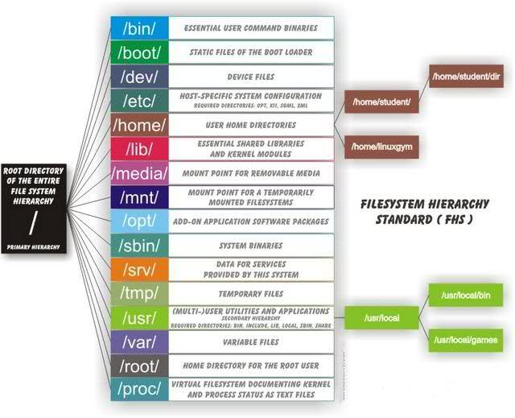
Linux Directory Structure

Slide 11
Virtual Machine vs. Container in Pictures
Guest OS
Guest OS
Guest OS
Virtual Machine
App
App
App
App
App
App
Libs
Libs
Libs
Libs
Libs
Libs
Guest OS
Guest OS
Guest OS
Container Manager
Hypervisor
Host OS
Hardware
Hardware
Hypervisor
Host OS
Container
Hardware

Slide 12
Virtual Machines vs. Containers
Virtual Machines
Containers
Hypervisor virtualizes the underlying physical hardware
Each VM contains a virtual copy of hardware, an OS and the application and its dependencies
Heavier weight: portable, but each VM must load and boot an OS
gigabytes
Still stuck scaling up a whole application when a component is overloaded
Containers virtualize the underlying operating system
Each container contains only the application and its dependencies
Lighter weight: fast and portable, because it leverages the host OS
Megabytes
Faster startup
Better use of hardware capacity
Speed enables microservice architecture that allows components of an application to scale with load

Slide 13
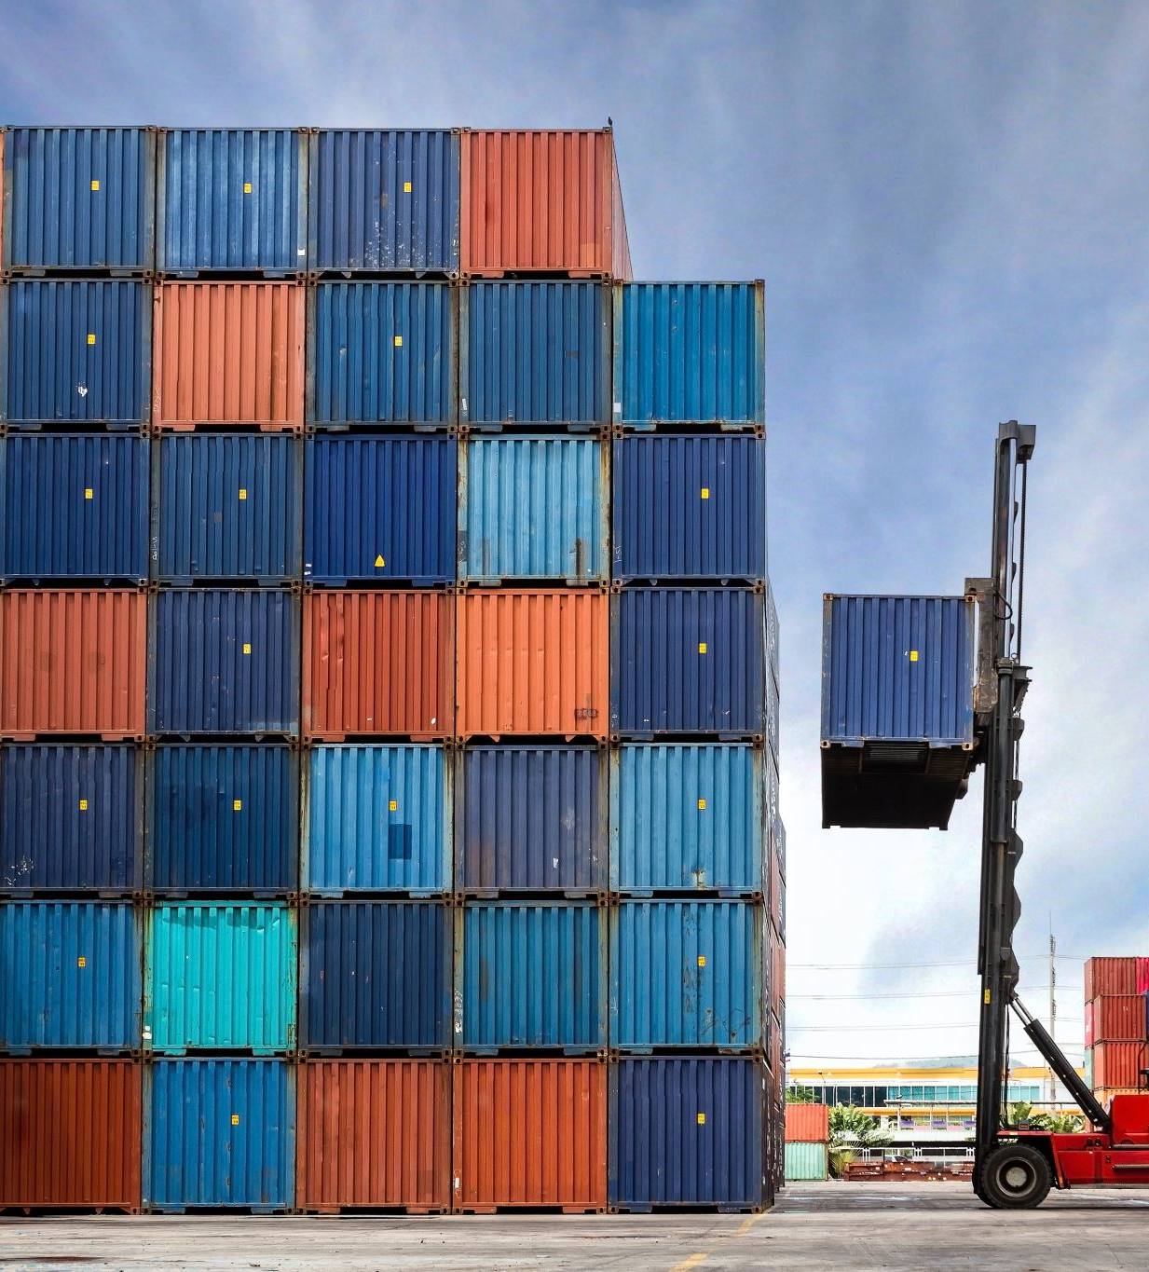

Docker
Popular container system
Automated container creation
You specify a DockerFile that describes the contents of your container.
Container versioning and rollback
Container reuse
You can build a new container by adding a layer to an existing container.
Shared Container libraries

Slide 14
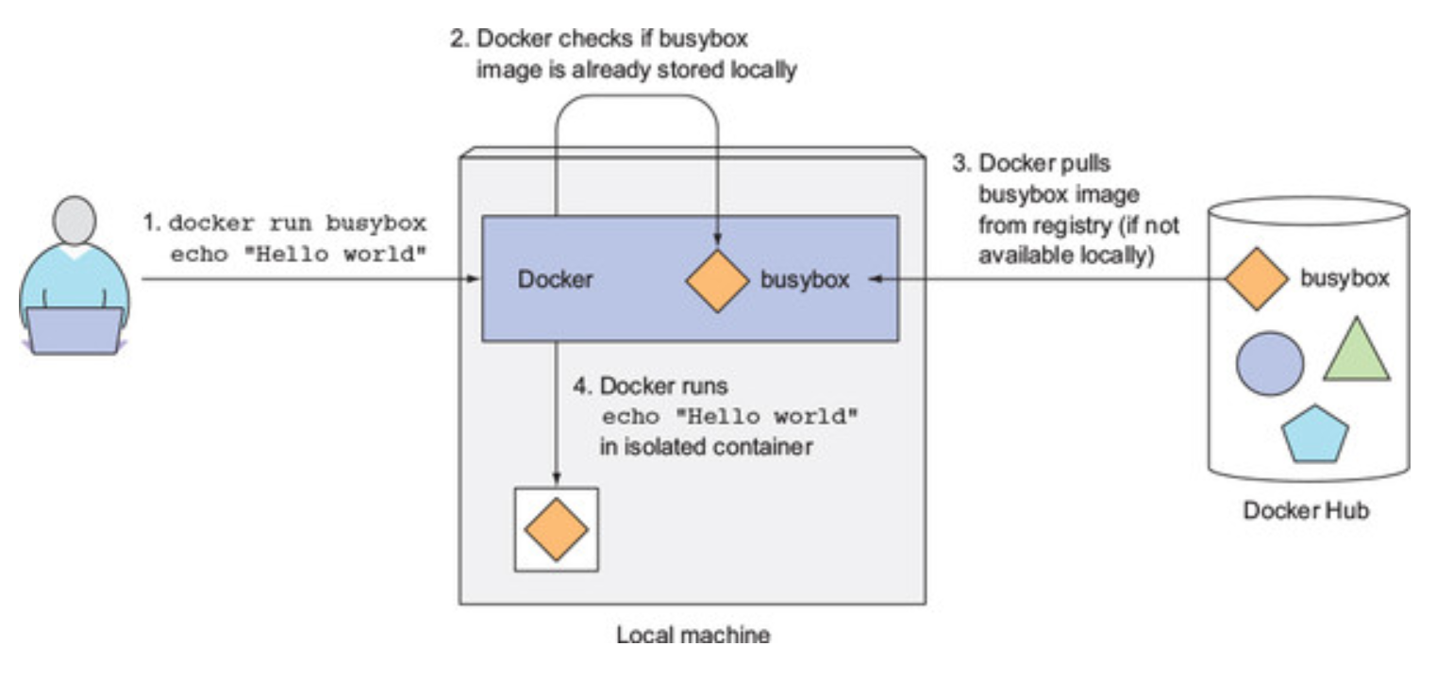
Running a Docker Image

Slide 15
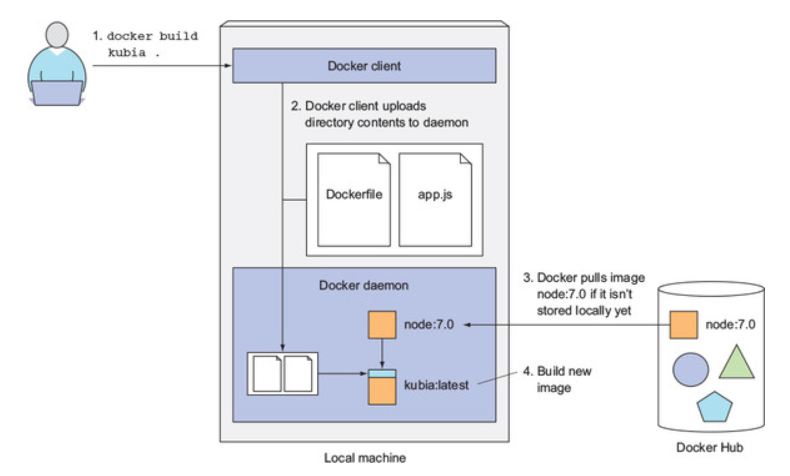
Creating a Docker Image
Dockerfile contents:
FROM node:7
ADD app.js / app.js
ENTRYPOINT [“node”, “app.js”]

Slide 16
Microservices
Containers allow us to create small services that we can start quickly and scale individually by adding a new instance (in a new container)
What problem do we next face?
App
App
App
App
App
App
Libs
Libs
Libs
Libs
Libs
Libs
Container Manager
Host OS
Hardware

Slide 17
Kubernetes/Orchestration
To solve the problem of growth in number and complexity of microservice deployments, we need to orchestrate the deployment, monitoring, and management of the services
Kubernetes is a popular orchestration engine that works with Docker.
Kubernetes manages a cluster of machines/virtual machines on which Docker contains can run.
In Kubernetes:
A pod is a unit of deployment consisting of one or more containers. All the containers in a pod are deployed to the same server.
Pods have a replica number. Kubernetes maintains the deployment at the required number of replicas. If a replica of a pod fails, a new replica of th epod is tarted.
A service is created from a set of pod replicas. It provides an ip address to the set of replicas that is external to the cluster, and it can provide load balancing across the replicas.
A good video overview of Kubernetes is “Kubernetes Explained” by Sai Vennam: https://www.youtube.com/watch?v=aSrqRSk43lY

Slide 18
Is orchestration of containers the only way to have microservices?
Serverless computing, for example with AWS Lambda, is another approach.

Slide 19
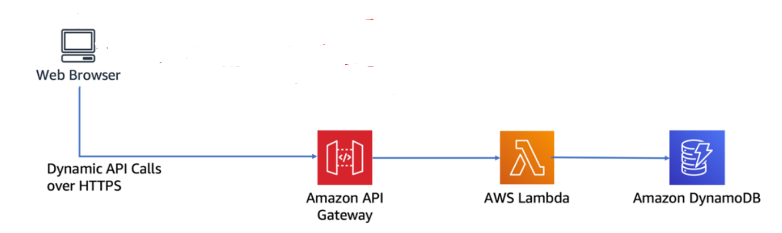
AWS Lambda
An activity in Module 6 will give you a demonstration of serverless computing with AWS Lambda.
Imagine creating a group of Lambda functions that work together in a microservices architecture.
To use a Lambda microservice, you need a trigger (e.g. CloudWatch) and perhaps a database.
Just this much can be done in the Learner Lab. To do the full example on building a serverless web application from https://aws.amazon.com/getting-started/hands-on/build-serverless-web-app-lambda-apigateway-s3-dynamodb-cognito/ , you would need to create an account and use the free tier + first year free services.
Use this link to discover what’s free if you create an account: https://aws.amazon.com/free/?all-free-tier.sort-by=item.additionalFields.SortRank&all-free-tier.sort-order=asc&awsf.Free%20Tier%20Types=*all&awsf.Free%20Tier%20Categories=*all

Slide 20
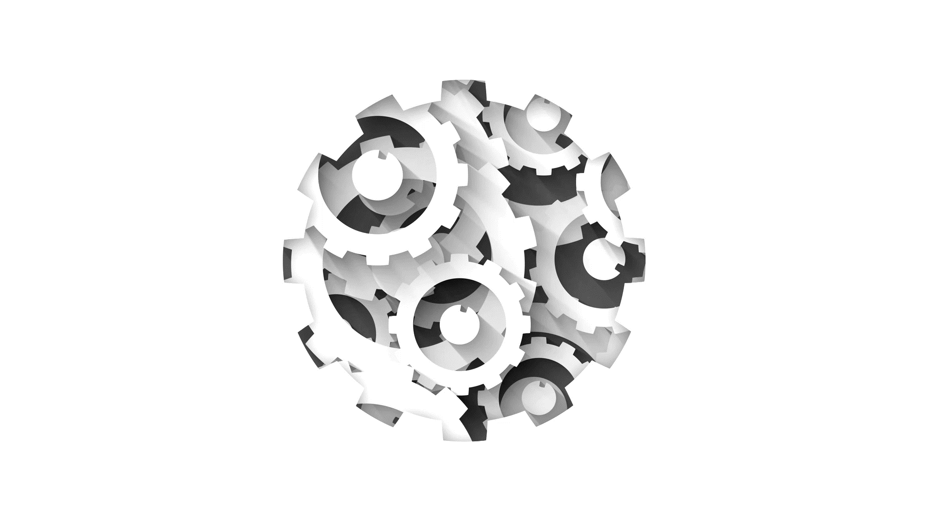
DevOps and Business Processes

Slide 21
What is your experience in software development?

Slide 22
Agile Development
Waterfall method – what came before
In 2001, the Agile Manifesto was published by a group of developers.
The Agile Manifesto put “individuals and interactions” first. It assumed that team members put a high value on technical excellence and working together to achieve their goal.
The point is, the team doing work decides how to do it. That is a fundamental agile principle. That even means if the team doesn’t want to work in an agile way, then agile probably isn't appropriate in that context, [not using agile] is the most agile way they can do things …
as quoted by R. Sethi (2021), Software Engineering Principles and Practices, pre-publication manuscript.

Slide 23

Principles in the Agile Manifesto
Self-organizing skilled teams
Satisfying customers through collaboration
Delivering working software frequently (in weeks, not months)
Accommodating requirements changes during development
Valuing simplicity and technical excellence

Slide 24
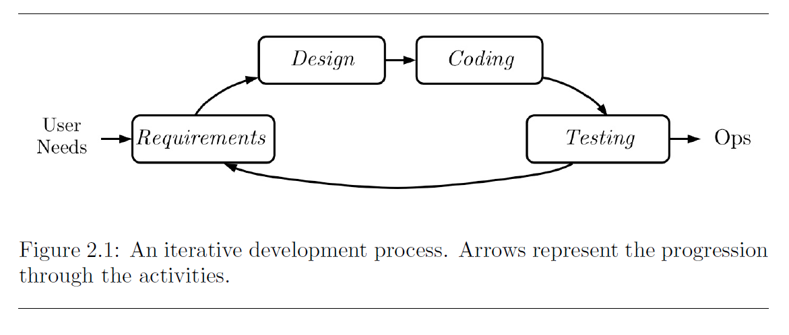
Iterative Development

Slide 25
Continuous Integration
Agile teams needed frequent integration to accomplish their goals
Nightly builds and automated testing became quite common
Leads naturally to continuous integration
Merge often to reduce conflicts
Merge at least once per day
Extensive regression testing
Benefits of continuous integration
Avoid Merge Hell
Always have a stable build

Slide 26
Continuous Deployment
Continuous Integration → Continuous Delivery → Continuous Deployment
Tools for Continuous Deployment
Tools suggested by IBM Video:
Version Control, Code Review
Continuous Integration
Configuration Management
Release Automation (Orchestration)
Infrastructure Monitoring (Performance Debugging)
DevOps
Development and Operations become a unified team

Slide 27
Facebook Guest Lecturer, Tony Savor
Savor, T., Douglas, M., Gentili, M., Williams, L., Beck, K., & Stumm, M. (2016, May). Continuous deployment at Facebook and OANDA. In 2016 IEEE/ACM 38th International Conference on Software Engineering Companion (ICSE-C) (pp. 21-30). IEEE. (10 pages) Available from the Rutgers Library: https://dl-acm-org.proxy.libraries.rutgers.edu/doi/abs/10.1145/2889160.2889223
https://www.youtube.com/watch?v=ERJZAwkHpX0

Slide 28
What software development principles do you get from this talk?

Slide 29
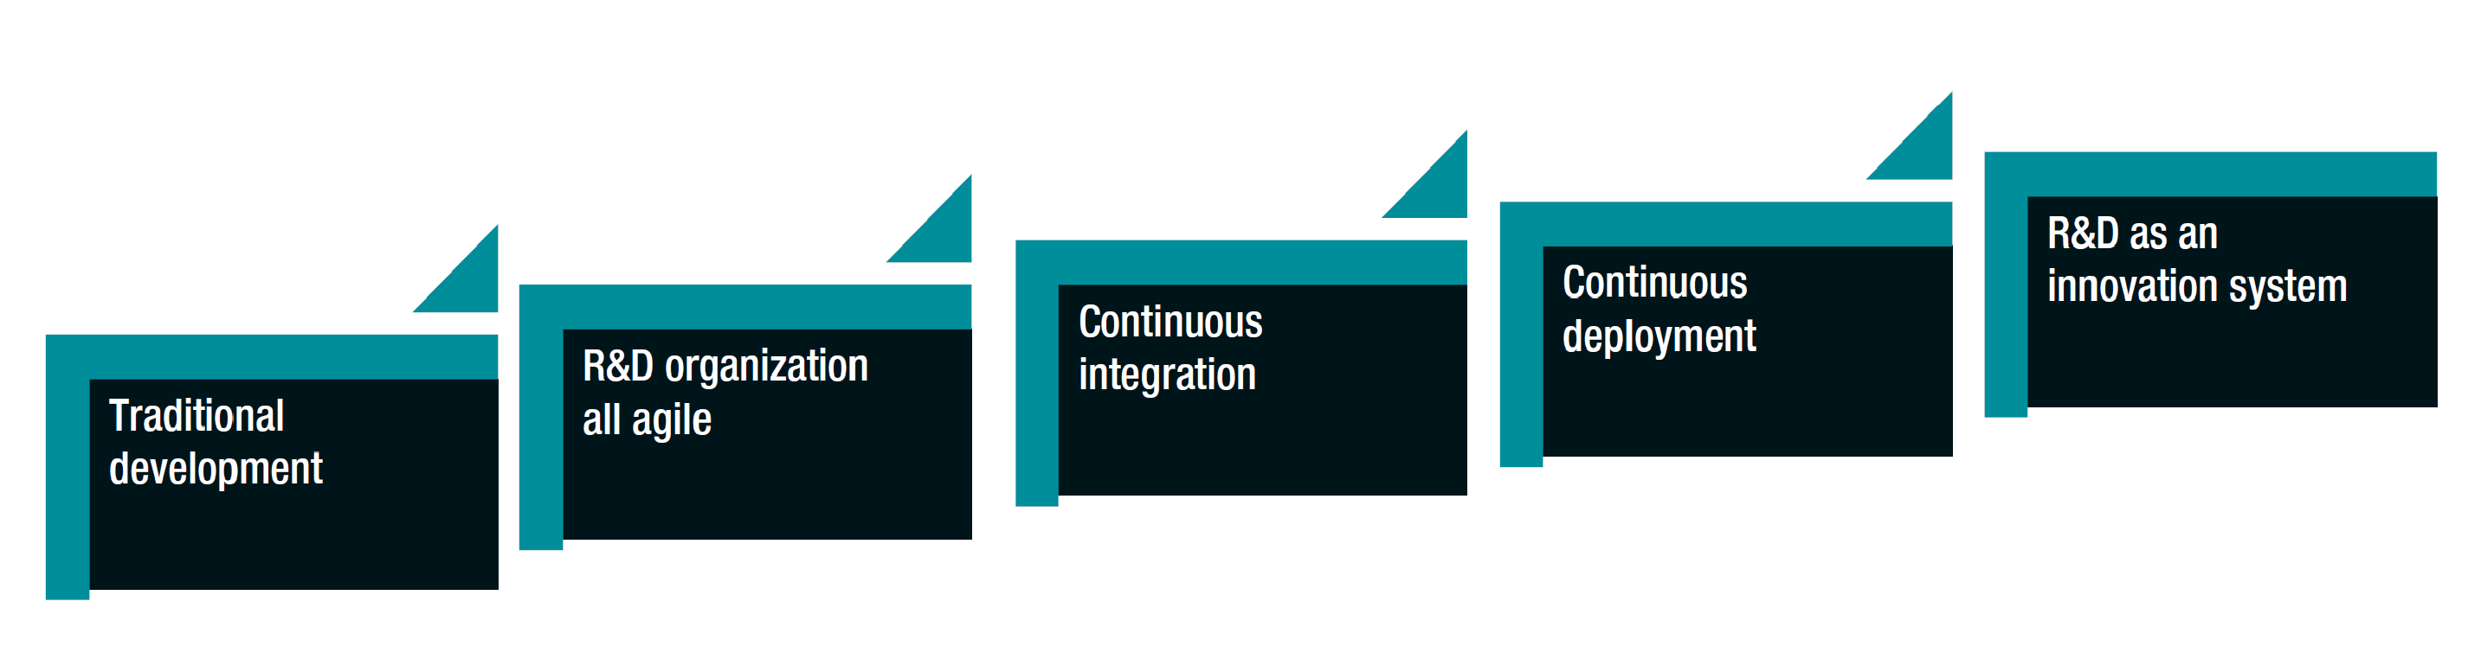
Stairway to Heaven
What’s needed to achieve continuous deployment?
How does R&D become an innovation engine after continuous deployment is in place?

Slide 30
Trends Contributing to the Need to Climb the Stairway
Shifting Nature of Production Innovation. Shift to hardware and software evolving independently. Customers expect their software to evolve.
From Products to Services. Move from CapEx to OpEx to foster agile response to customers. Companies moving from selling/buying products to selling/buying services.
From Technology-Driven to Customer-Driven Innovation. Technology may become available to everyone at the same time providing no differentiation. You must work with / experiment with the customer to understand their unspoken needs.
Growing Software Size. Software intensive system increase in size by an order of magnitude every 5 to 10 years necessitating new architectures and processes.
The Need for Speed. Faster adoption rates by consumers and companies. New customer needs and requests are coming in faster. Leads to new architectures and software development/deployment processes.
Playing Nice with Others. More and more companies succeed by creating/participating in an ecosystem of software.

Slide 31
Key Evolving Requirements are Producing a Variety of Changes
According to Jan Bosch
The need for speed, data, and cooperation in software ecosystem
Leads to changes in
business
architecture
process
organization framework

Slide 32
Now and Future Changes
Transition from planning to experimentation
Invest in features customers use. Experiment with new features.
Adoption of ecosystem principles
Hierarchies and traditional function are no longer sufficiently fast and efficient
Teams need autonomy to make decisions locally
View system as having autonomous organizational units
Architecture
Unprecedented architecture modularity and flexibility
Continuous refactoring
Autonomy
Integral Data Collection
Control and change system behavior
Discern the results of experimentation with users
Process
Stairway to Heaven
Organization
Cross-Functional Teams
Self-Management
Business

Slide 33
What kind of experimentation can you do with customers?

Slide 34
Lightweight Teams
Take a moment to review the Netflix and Betabrand Experience Reports
What do these experiences illustrate?

Slide 35

AWS Academy Cloud Foundation Modules
Questions from the modules so far
You may need to pause the videos and google some terms
Post questions on group me if something is unclear, and I or a classmate will fill the background
© 2022 Joann J Ordille, joann.ordille@rutgers.edu

Slide 36
AWS Regions and Availability Zones
To learn more about the AWS Regions that are currently available, use one of the following links:
https://aws.amazon.com/about-aws/global-infrastructure/#AWS_Global_Infrastructure_Map
https://aws.amazon.com/about-aws/global-infrastructure/regions_az/
These resources are updated frequently to show current and planned AWS infrastructure.
© 2022 Amazon Web Services, Inc. or its Affiliates, All rights reserved.

Slide 37
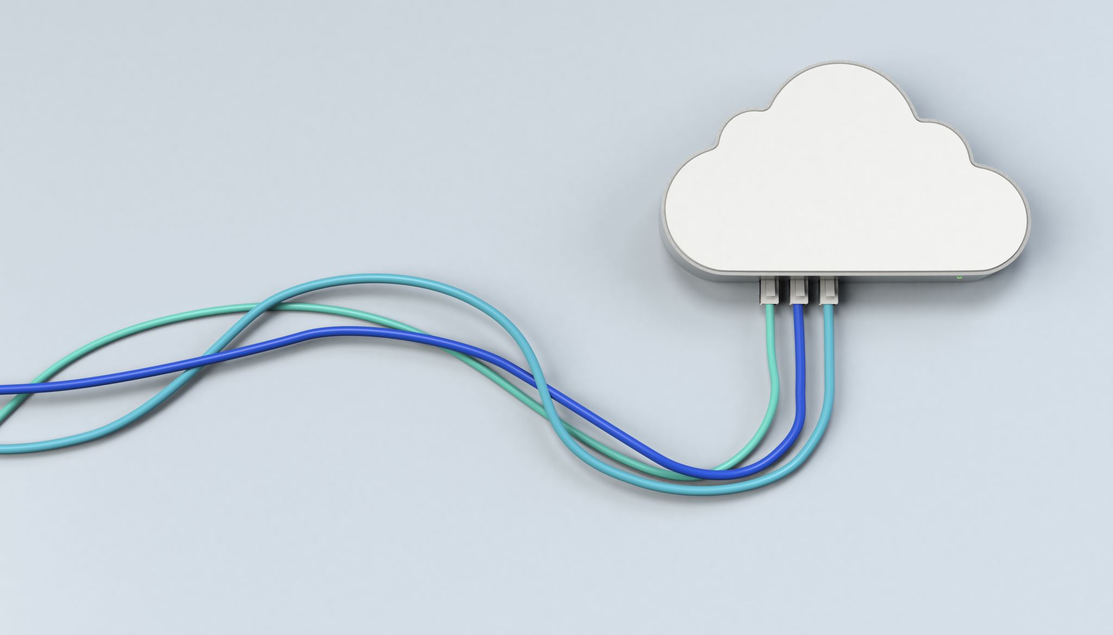
AWS Cloud Security Module

Slide 38
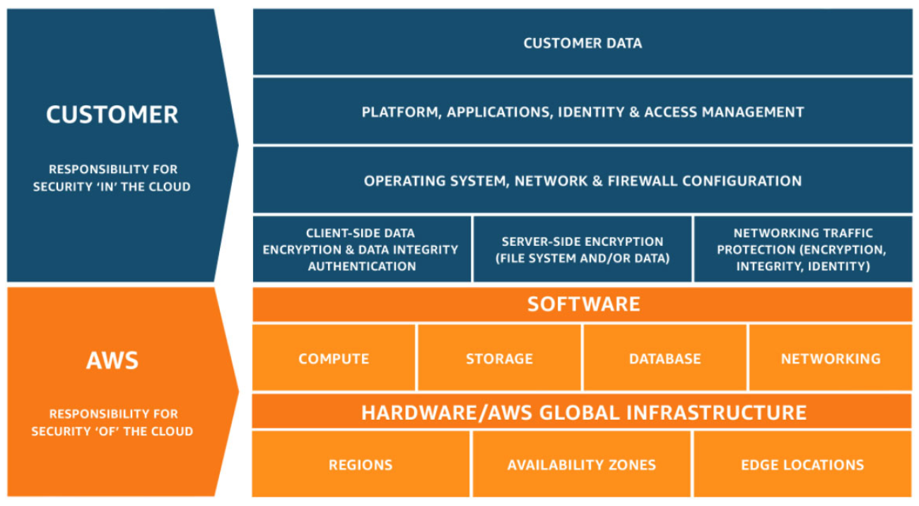
AWS shared responsibility model
Notes:
Security and compliance are a shared responsibility between AWS and the customer. This shared responsibility model is designed to help relieve the customer’s operational burden. At the same time, to provide the flexibility and customer control that enables the deployment of customer solutions on AWS, the customer remains responsible for some aspects of the overall security. The differentiation of who is responsible for what is commonly referred to as security “of” the cloud versus security “in” the cloud.
AWS operates, manages, and controls the components from the software virtualization layer down to the physical security of the facilities where AWS services operate. AWS is responsible for protecting the infrastructure that runs all the services that are offered in the AWS Cloud. This infrastructure is composed of the hardware, software, networking, and facilities that run the AWS Cloud services.
The customer is responsible for the encryption of data at rest and data in transit. The customer should also ensure that the network is configured for security and that security credentials and logins are managed safely. Additionally, the customer is responsible for the configuration of security groups and the configuration of the operating system that run on compute instances that they launch (including updates and security patches).

Slide 39




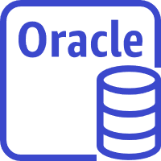
Activity: Scenario 1 of 2
Consider this deployment. Who is responsible – AWS or the customer?
AWS Cloud
Upgrades and patches to the operating system on the EC2 instance?
Physical security of the data center?
Virtualization infrastructure?
EC2 security group settings?
Configuration of applications that run on the EC2 instance?
Oracle upgrades or patches If the Oracle instance runs as an Amazon RDS instance?
Oracle upgrades or patches If Oracle runs on an EC2 instance?
S3 bucket access configuration?
Virtual Private Cloud (VPC)
Amazon Simple Storage Service (Amazon S3)
Amazon EC2
Oracle instance
AWS Global Infrastructure
Notes:
Consider the case where a customer uses the AWS services and resources that are shown here. Who is responsible for maintaining security? AWS or the customer?

Slide 40
Activity: Scenario 1 of 2 Answers
Consider this deployment. Who is responsible – AWS or the customer?
AWS Cloud
Upgrades and patches to the operating system on the EC2 instance?
ANSWER: The customer
Physical security of the data center?
ANSWER: AWS
Virtualization infrastructure?
ANSWER: AWS
EC2 security group settings?
ANSWER: The customer
Configuration of applications that run on the EC2 instance?
ANSWER: The customer
Oracle upgrades or patches If the Oracle instance runs as an Amazon RDS instance?
ANSWER: AWS
Oracle upgrades or patches If Oracle runs on an EC2 instance?
ANSWER: The customer
S3 bucket access configuration?
ANSWER: The customer
Virtual Private Cloud (VPC)
Amazon Simple Storage Service (Amazon S3)
Amazon EC2
Oracle instance
AWS Global Infrastructure
Notes:
The customer uses Amazon Simple Storage Service (Amazon S3) to store data. The customer configured a virtual private cloud (VPC) with Amazon Virtual Private Cloud (Amazon VPC). The EC2 instance and the Oracle database instance that they created both run in the VPC.
In this example, the customer must manage the guest operating system (OS) that runs on the EC2 instance. Over time, the guest OS will need to be upgraded and have security patches applied. Additionally, any application software or utilities that the customer installed on the Amazon EC2 instance must also be maintained. The customer is responsible for configuring the AWS firewall (or security group) that is applied to the Amazon EC2 instance. The customer is also responsible for the VPC configurations that specify the network conditions in which the Amazon EC2 instance runs. These tasks are the same security tasks that IT staff would perform, no matter where their servers are located.
The Oracle instance in this example provides an interesting case study in terms of AWS or customer responsibility. If the database runs on an EC2 instance, then it is the customer's responsibility to apply Oracle software upgrades and patches. However, if the database runs as an Amazon RDS instance, then it is the responsibility of AWS to apply Oracle software upgrades and patches. Because Amazon RDS is a managed database offering, time-consuming database administration tasks—which include provisioning, backups, software patching, monitoring, and hardware scaling—are handled by AWS. To learn more, see Best Practices for Running Oracle Database on AWS at https://docs.aws.amazon.com/whitepapers/latest/oracle-database-aws-best-practices/oracle-database-aws-best-practices.html for details.

Slide 41

Section 2 key takeaways
IAM policies are constructed with JavaScript Object Notation (JSON) and define permissions.
IAM policies can be attached to any IAM entity.
Entities are IAM users, IAM groups, and IAM roles.
An IAM user provides a way for a person, application, or service to authenticate to AWS.
An IAM group is a simple way to attach the same policies to multiple users.
An IAM role can have permissions policies attached to it and can be used to delegate temporary access to users or applications.
Notes:
Some key takeaways from this section of the module include:
IAM policies are constructed with JavaScript Object Notation (JSON) and define permissions.
IAM policies can be attached to any IAM entity.
Entities are IAM users, IAM groups, and IAM roles.
An IAM user provides a way for a person, application, or service to authenticate to AWS.
An IAM group is a simple way to attach the same policies to multiple users.
An IAM role can have permissions policies attached to it, and can be used to delegate temporary access to users or applications.

Slide 42






Example use of an IAM role
Scenario:
An application that runs on an EC2 instance needs access to an S3 bucket
Solution:
Define an IAM policy that grants access to the S3 bucket.
Attach the policy to a role
Allow the EC2 instance to assume the role
AWS Cloud
Application has permissions to access the S3 bucket
Amazon EC2 instance
Application
3
Amazon S3 bucket photos
Role assumed by the EC2 instance
2
attached
IAM role
1
IAM policy grants access to photos bucket
Notes:
In the diagram, a developer runs an application on an EC2 instance that requires access to the S3 bucket that is named photos. An administrator creates the IAM role and attaches the role to the EC2 instance. The role includes a permissions policy that grants read-only access to the specified S3 bucket. It also includes a trust policy that allows the EC2 instance to assume the role and retrieve the temporary credentials. When the application runs on the instance, it can use the role's temporary credentials to access the photos bucket. The administrator does not need to grant the application developer permission to access the photos bucket, and the developer never needs to share or manage credentials.
To learn more details about this example, see Using an IAM Role to Grant Permissions to Applications Running on Amazon EC2 Instances at https://docs.aws.amazon.com/IAM/latest/UserGuide/id_roles_use_switch-role-ec2.html.

Slide 43

Note
An IAM Group is NOT the same as a Security Group
A Security Group controls network traffic in and out of your AWS resource, for example in/out of your EC2 instance or your VPC

Slide 44

AWS Networking and Content Delivery Module

Slide 45


Networks
Subnet 1
Subnet 2
Router
Notes:
A computer network is two or more client machines that are connected together to share resources. A network can be logically partitioned into subnets. Networking requires a networking device (such as a router or switch) to connect all the clients together and enable communication between them.

Slide 46
IP addresses
192
.
0
.
2
.
0
11000000
00000000
00000010
00000000
Notes:
Each client machine in a network has a unique Internet Protocol (IP) address that identifies it. An IP address is a numerical label in decimal format. Machines convert that decimal number to a binary format.
In this example, the IP address is 192.0.2.0. Each of the four dot (.)-separated numbers of the IP address represents 8 bits in octal number format. That means each of the four numbers can be anything from 0 to 255. The combined total of the four numbers for an IP address is 32 bits in binary format.

Slide 47
IPv4 and IPv6 addresses
IPv4 (32-bit) address: 192.0.2.0
IPv6 (128-bit) address: 2600:1f18:22ba:8c00:ba86:a05e:a5ba:00FF
Notes:
A 32-bit IP address is called an IPv4 address.
IPv6 addresses, which are 128 bits, are also available. IPv6 addresses can accommodate more user devices.
An IPv6 address is composed of eight groups of four letters and numbers that are separated by colons (:). In this example, the IPv6 address is 2600:1f18:22ba:8c00:ba86:a05e:a5ba:00FF. Each of the eight colon-separated groups of the IPv6 address represents 16 bits in hexadecimal number format. That means each of the eight groups can be anything from 0 to FFFF. The combined total of the eight groups for an IPv6 address is 128 bits in binary format.

Slide 48
Classless Inter-Domain Routing (CIDR)
Network identifier (routing prefix)
Host identifier
192
.
0
.
2
.
0
/
24
Tells you how many bits are fixed
11000000
00000000
00000010
00000000 to 11111111
Fixed
Fixed
Fixed
Flexible
Notes:
A common method to describe networks is Classless Inter-Domain Routing (CIDR). The CIDR address is expressed as follows:
An IP address (which is the first address of the network)
Next, a slash character (/)
Finally, a number that tells you how many bits of the routing prefix must be fixed or allocated for the network identifier
The bits that are not fixed are allowed to change. CIDR is a way to express a group of IP addresses that are consecutive to each other.
In this example, the CIDR address is 192.0.2.0/24. The last number (24) tells you that the first 24 bits must be fixed. The last 8 bits are flexible, which means that 2⁸ (or 256) IP addresses are available for the network, which range from 192.0.2.0 to 192.0.2.255. The fourth decimal digit is allowed to change from 0 to 255.
If the CIDR was 192.0.2.0/16, the last number (16) tells you that the first 16 bits must be fixed. The last 16 bits are flexible, which means that 2¹⁶ (or 65,536) IP addresses are available for the network, ranging from 192.0.0.0 to 192.0.255.255. The third and fourth decimal digits can each change from 0 to 255.
There are two special cases:
Fixed IP addresses, in which every bit is fixed, represent a single IP address (for example, 192.0.2.0/32). This type of address is helpful when you want to set up a firewall rule and give access to a specific host.
The internet, in which every bit is flexible, is represented as 0.0.0.0/0

Slide 49
More information on CIDR
https://en.wikipedia.org/wiki/Classless_Inter-Domain_Routing
The Wikipedia article gives a full list of IPv4 CIDR blocks.

Slide 50
IP addressing
When you create a VPC, you assign it to an IPv4 CIDR block (range of private IPv4 addresses).
You cannot change the address range after you create the VPC.
The largest IPv4 CIDR block size is /16.
The smallest IPv4 CIDR block size is /28.
IPv6 is also supported (with a different block size limit).
CIDR blocks of subnets cannot overlap.
VPC
x.x.x.x/16 or 65,536 addresses (max)
to x.x.x.x/28 or 16 addresses (min)
Notes:
IP addresses enable resources in your VPC to communicate with each other and with resources over the internet. When you create a VPC, you assign an IPv4 CIDR block (a range of private IPv4 addresses) to it. After you create a VPC, you cannot change the address range, so it is important that you choose it carefully. The IPv4 CIDR block might be as large as /16 (which is 2¹⁶, or 65,536 addresses) or as small as /28 (which is 2⁴, or 16 addresses).
You can optionally associate an IPv6 CIDR block with your VPC and subnets, and assign IPv6 addresses from that block to the resources in your VPC. IPv6 CIDR blocks have a different block size limit.
The CIDR block of a subnet can be the same as the CIDR block for a VPC. In this case, the VPC and the subnet are the same size (a single subnet in the VPC). Also, the CIDR block of a subnet can be a subset of the CIDR block for the VPC. This structure enables the definition of multiple subnets. If you create more than one subnet in a VPC, the CIDR blocks of the subnets cannot overlap. You cannot have duplicate IP addresses in the same VPC.
To learn more about IP addressing in a VPC, see the AWS Documentation at https://docs.aws.amazon.com/vpc/latest/userguide/what-is-amazon-vpc.html.

Slide 51

Reserved IP addresses
Example: A VPC with an IPv4 CIDR block of 10.0.0.0/16 has 65,536 total IP addresses. The VPC has four equal-sized subnets. Only 251 IP addresses are available for use by each subnet.
IP Addresses for CIDR block 10.0.0.0/24 | Reserved for
10.0.0.0 | Network address
10.0.0.1 | Internal communication
10.0.0.2 | Domain Name System (DNS) resolution
10.0.0.3 | Future use
10.0.0.255 | Network broadcast address
VPC: 10.0.0.0/16
Subnet 1 (10.0.0.0/24)
Subnet 2 (10.0.2.0/24)
251 IP addresses
251 IP addresses
Subnet 4 (10.0.1.0/24)
Subnet 3 (10.0.3.0/24)
251 IP addresses
251 IP addresses
Notes:
When you create a subnet, it requires its own CIDR block. For each CIDR block that you specify, AWS reserves five IP addresses within that block, and these addresses are not available for use. AWS reserves these IP addresses for:
Network address
VPC local router (internal communications)
Domain Name System (DNS) resolution
Future use
Network broadcast address
For example, suppose that you create a subnet with an IPv4 CIDR block of 10.0.0.0/24 (which has 256 total IP addresses). The subnet has 256 IP addresses, but only 251 are available because five are reserved.

Slide 52

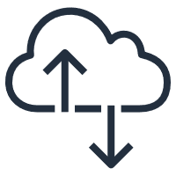
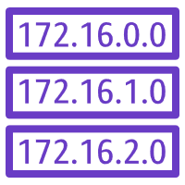


Internet gateway
AWS Cloud
Region
Availability Zone
VPC: 10.0.0.0/16
Public Subnet Route Table
Public subnet:10.0.1.0/24
Destination | Target
10.0.0.0/16 | local
0.0.0.0/0 | igw-id
Private subnet: 10.0.2.0/24
Route table
Internet gateway
(igw-id)
Internet
Notes:
An internet gateway is a scalable, redundant, and highly available VPC component that allows communication between instances in your VPC and the internet. An internet gateway serves two purposes: to provide a target in your VPC route tables for internet-routable traffic, and to perform network address translation for instances that were assigned public IPv4 addresses.
To make a subnet public, you attach an internet gateway to your VPC and add a route to the route table to send non-local traffic through the internet gateway to the internet (0.0.0.0/0).
For more information about internet gateways, see Internet Gateways in the AWS Documentation at https://docs.aws.amazon.com/vpc/latest/userguide/VPC_Internet_Gateway.html.

Slide 53

Network address translation (NAT) gateway
AWS Cloud
Region
Availability Zone
VPC: 10.0.0.0/16
Public subnet:10.0.1.0/24
Public Subnet Route Table
Public route table
Destination | Target
10.0.0.0/16 | local
0.0.0.0/0 | igw-id
NAT gateway (nat-gw-id)
Private subnet: 10.0.2.0/24
Internet gateway
(igw-id)
Private route table
Private Subnet Route Table
Internet
Destination | Target
10.0.0.0/16 | local
0.0.0.0/0 | nat-gw-id
Notes:
A network address translation (NAT) gateway enables instances in a private subnet to connect to the internet or other AWS services, but prevents the internet from initiating a connection with those instances.
To create a NAT gateway, you must specify the public subnet in which the NAT gateway should reside. You must also specify an Elastic IP address to associate with the NAT gateway when you create it. After you create a NAT gateway, you must update the route table that is associated with one or more of your private subnets to point internet-bound traffic to the NAT gateway. Thus, instances in your private subnets can communicate with the internet.
You can also use a NAT instance in a public subnet in your VPC instead of a NAT gateway. However, a NAT gateway is a managed NAT service that provides better availability, higher bandwidth, and less administrative effort. For common use cases, AWS recommends that you use a NAT gateway instead of a NAT instance.
See the AWS Documentation for more information about
NAT gateways at https://docs.aws.amazon.com/vpc/latest/userguide/vpc-nat-gateway.html.
NAT instances at https://docs.aws.amazon.com/vpc/latest/userguide/VPC_NAT_Instance.html.
Differences between NAT gateways and NAT instances at https://docs.aws.amazon.com/vpc/latest/userguide/vpc-nat-comparison.html.

Slide 54
Things Due Soon
Reading Assignment on Canvas
01
AWS Cloud Foundations Modules 5-6 including two labs
02
Learn/review bash
03
Unless noted, pictures, illustrations and graphics were created by Joann J Ordille and/or fully or partially generated by PowerPoint.

Slide 55
Useful Shell Commands
Command | Description
ls | List the files in the directory
clear | Clears your window
cat {file} | Send (concatenate) the contents of {file} to the window
pwd | Print working directory (directory I’m in)
cd {new-directory) | Change the working directory (.. is up one, ../.. Is up two)
touch {file} | Create file if it doesn’t exist, or update its modification date if it does
less | A pun or the previous program more. Display the file in pages. Use a space to advance to the next page and q to quit.
tail {file} | Display the last lines {file}. Include –n where n is a number to say the number of lines you want.
history | Show history of commands entered
up arrow, down arrow | Move around in the history to pick a previous command to run again with enter, or to edit and then run again
nano {file} | A full screen file editor that has a list of command keys (for write out, exit) at the bottom. Move around with the arrow keys. Delete keys work. Be sure to read the prompt and answer the question about saving the file when you exit.
Invest 1 hour in the youTube video: Beginner’s Guide to the Bash Terminal
It is helpful to know bash when working with NoSQL Databases and Amazon Web Services.

